Slide 1
Notes:
For 20 years our company was known as Destination Analysts, until we announced in August our rebranding to Future Partners. But while the name has changed, [clilck] Our work continues to open our clients opportunity powered by insight and brings the future of travel within reach. Our commitment to you, our peers in the travel industry is unwavering—and we look forward to continue to partner with you in support of your business goals and towards a prosperous travel indsutry

Slide 2
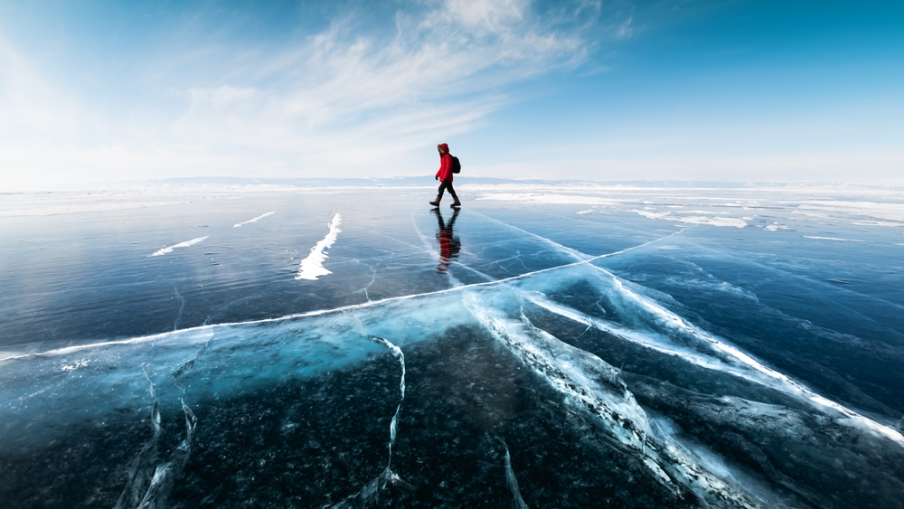
December 2023
The State of the American Traveler

Slide 3
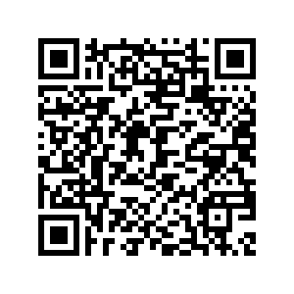
Presentation deck and recording will be available on our website:
FuturePartners.com
January Livestream
Registration
Notes:
You are, of course, welcome to take screenshots and notes, but do know that this deck and the recording will be made available to you on our website, FuturePartners.com, shortly after the conclusion of this livestream.

Slide 4
Today
Travel Sentiment Overview
Special Questions: Saving and Travel
Travel Hot Takes Panel
January Livestream
Registration
The State of the American Traveler, November 2023

Slide 5
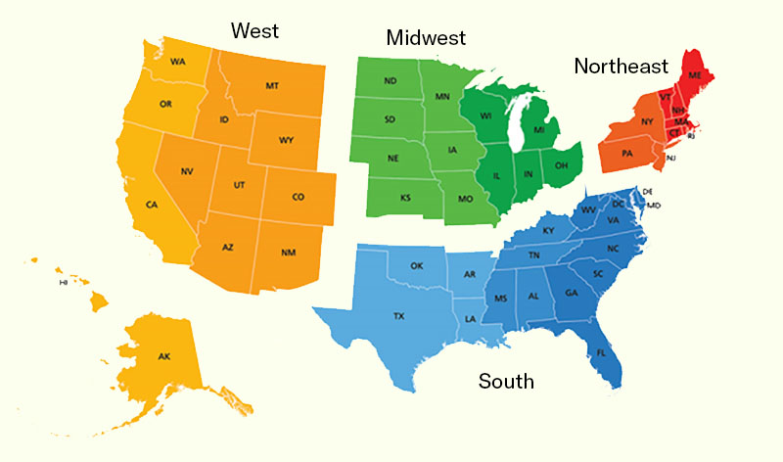
Methodology
Monthly tracking survey
Representative sample of adult American travelers in each of four U.S. regions
Tracks traveler sentiment to generate insights into domestic travel trends
Survey collected: November 17-21
4,000+ fully completed surveys collected each wave
Confidence interval of +/- 1.55%
Data is weighted to reflect the actual population of each region
United States Census Regions
West
Midwest
Northeast
South
Notes:
A quick recap of the methodology employed with The State of the American Traveler. Started in 2006, this is a monthly tracking survey of a representative sample of 4,000 adult American travelers across each of the major regions of the U.S. Data presented today was collected September 17-21, is weighted to reflect the population of the U.S. and has a confidence interval of +/- 1. 55%

Slide 6
Audience Poll:
I prefer to spend money now and worry about the future later.
I strike a balance between enjoying life now and saving for the future.
I prioritize saving for the future over enjoying life in the present.
Question:
Which of the following best describes your attitude toward spending money now versus saving for the future? (Select one)
Notes:
Unfortunately, Recession Fears are Driving Increasing Spending Caution, with [click] 63.9% of American travelers saying they are being careful with their money bc they are concerned about an upcoming recession and just [click] 12.6% saying that doesn’t describe their behavior

Slide 7
Current Sentiment
January Livestream
Registration
Notes:
We look forward to bringing our experience and expertise…

Slide 8
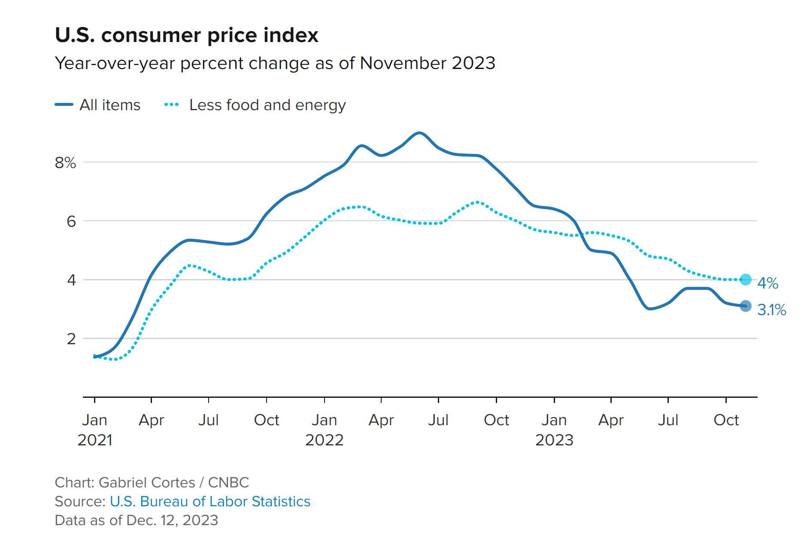
Inflation has weakened
Notes:
Unfortunately, Recession Fears are Driving Increasing Spending Caution, with [click] 63.9% of American travelers saying they are being careful with their money bc they are concerned about an upcoming recession and just [click] 12.6% saying that doesn’t describe their behavior

Slide 9
GDP growth was strong in Q3
+199,000 jobs in November
Unemployment rate drops to 3.7%
Real GDP - % Change
Source: US Department of Commerce, Bureau of Economic Analysis
Notes:
Unfortunately, Recession Fears are Driving Increasing Spending Caution, with [click] 63.9% of American travelers saying they are being careful with their money bc they are concerned about an upcoming recession and just [click] 12.6% saying that doesn’t describe their behavior

Slide 10
Travelers’ personal financial situation are solid, and the feeling that now is a good time to spend on travel continues to improve.
January Livestream
Registration
Notes:
To summarize, compared a year earlier, travelers are feeling somewhat better-off. Affluent, urban and younger travelers are driving our overall sense of financial well-being.

Slide 11
Current financial sentiment moderated slightly this month.
Question:
Would you say that you (and your household) are better off or worse off financially than you were a year ago?
34.1%
34.1%
Notes:
And as we all know, money is foundational. Well, travelers continue to be somewhat split on perceptions of their current financial situation. [click] While 28.4% say they are better off now than they were a year ago, [click] 35.2% characterize themselves as worse off financially.

Slide 12
Current financial sentiment moderated slightly this month.
Question:
Would you say that you (and your household) are better off or worse off financially than you were a year ago?
% Better off or Much better off
No. 2022 = 26.3% Nov. 2023 = 34.1%
Notes:
This is a time series of the percent of Amricans who are feeling they are better off in the present compared to the year prior. In a historic context we see there has actually been a Small Improvement in Financial Sentiment this Month—as well as Year-Over-Year– last September just 25% felt their present financial situation improved, that is up 3.4 points in 2023

Slide 13
The belief that now is a good time to spend on travel is improving…
Question:
Thinking only of your household's finances, do you feel NOW is a good or bad time for you to spend money on leisure travel?
34.4%
34.8%
Notes:
The Belief that the present is a Bad Time to Spend on Travel Remains Elevated [click click ] with 37.9% of Americans saying this, nearly 10 points higher [click] than the 28.1% who say it is a good time

Slide 14
…as positive feelings toward travel spending continue to grow.
Question:
Thinking only of your household's finances, do you feel NOW is a good or bad time for you to spend money on leisure travel?
% Good time or Very good time
Notes:
But Positive Feelings Toward Travel Spending did Rebound this Month, as you can see in this time series chart plotting the percent who feeling like the present is a good time to spend on travel from January 2022 to now. This metric really took a dive in Spring of last year when inflation and recession really became dominant in the media. It recovered at the start of this year but declined again this summer. Hopefully the upward momentum we see this month holds.

Slide 15
Economic uncertainty continues to be at significant levels, but concerns about a coming recession are subsiding.
January Livestream
Registration
Notes:
To summarize, compared a year earlier, travelers are feeling somewhat better-off. Affluent, urban and younger travelers are driving our overall sense of financial well-being.

Slide 16
Economic uncertainty continues for many travelers…
Question:
I expect the United States will enter an economic recession sometime in the NEXT SIX (6) MONTHS.
48.4%
17.6%
Notes:
A Significant Sense of Economic Uncertainty Exists among American travelers. [click] Over 52% expect the US to enter a recession in the next 6 months. [click] Just 15.5% disagree with this prediction

Slide 17
…but this metric dropped significantly this month.
Statement:
I expect the United States will enter an economic recession sometime in the NEXT SIX (6) MONTHS.
% Agree or Strongly agree
Post-pandemic low
Notes:
This anxiety about a recession increased slightly this month– although note that it is over 11 points lower than at the same time last year when it was near peak levels

Slide 18
Spending caution continues to be impacted by recessionary concerns.
Statement:
Right now, I am being careful with my money because I'm concerned about an upcoming recession.
55.2%
15.9%
Notes:
Unfortunately, Recession Fears are Driving Increasing Spending Caution, with [click] 63.9% of American travelers saying they are being careful with their money bc they are concerned about an upcoming recession and just [click] 12.6% saying that doesn’t describe their behavior

Slide 19
This spending caution dropped sharply in November.
Statement:
Right now, I am being careful with my money because I'm concerned about an upcoming recession.
% Agree or Strongly agree
Time series low
Notes:
As you can see in this time series chart going back to a year ago, this Spending Caution Worsened this Month. However, it does remain slightly below where it was a year ago

Slide 20
High costs remain the top impediment to travel
Question:
In the PAST SIX (6) MONTHS, which (if any) of the following have kept you from traveling more than you would have otherwise preferred? (Select all that apply)
Notes:
When we look at the current detterrents to travel—what Americans say kept them from traveling as much as they would have otherwise, High Costs Remain the Top Impediment to Travel [click] including travel is too expensive right now, personal finances, gas being too expensive and airfare too expensive. Note that over 80% of Americans cited at least one travel deterrent

Slide 21
Expense as a deterrent to travel decreased again in November.
Question:
In the PAST SIX (6) MONTHS, which (if any) of the following have kept you from traveling more than you would have otherwise preferred? (Select all that apply)
% Travel is too expensive right now
2022
2023
Post-pandemic low
Notes:
Compared to last month, there was Slight Improvement in Travel being too Expensive Acting as a Deterrent. And If we compare back to the same period 2022—price has been slightly more of an issue this year

Slide 22
Fewer said travel prices kept them from traveling last month
Statement:
High travel prices have kept me from traveling in the past month.
43.4%
Notes:
In fact, 47.1%, nearly Half of American Travelers Say High Travel Prices Kept them from Traveling Last Month. This has been on the rise over the last 3 months and is at the same level it was at the same point last year. The last time more Americans said high travel prices DIDN’T keep them from traveling in the past month than did was in April 2022

Slide 23
While travel continues to face headwinds from high prices and spending caution, travel volume continues to be robust
January Livestream
Registration
Notes:
To summarize, Travel headwinds continue from high prices and spending caution resulting from recession fears. The single biggest impediment to travel right now is high costs.

Slide 24
Overnight trip volume remains robust.
Question:
How many OVERNIGHT trips of each type have you taken in the PAST MONTH?
2022
2023
Notes:
But thus far, the traveling consumer has remained pretty resilient. Overnight trip volume amongst Americans remains robust, with 61.4% taking at least one trip in the last month, that is more than 11 points above September of 2022. The average American traveler reports taking 2.9 trips in the past month—among the highest it has been all year and well above the average of 1.7 trips reported last September.

Slide 25
Day trip volume has been very strong this year.
2022
2023
Question:
How many DAY TRIPS (i.e., no overnight stay) of each type have you taken in the PAST MONTH?
Notes:
As we have been reporting, leisure day trip volume has been particularly strong this year. 68.4% of American travelers said they took a leisure day trip in the past month--That is 20 points higher than in September 2022. They typical American traveler took 3.3 leisure day trips in the past month

Slide 26
Looking Forward
Notes:
I will now walk you through what you may be able to forecast or expect from what American travelers share when we ask them to look forward.

Slide 27
Travelers are optimistic about their finances and continue to hold high levels of excitement for travel.
January Livestream
Registration
Notes:
To summarize, compared a year earlier, travelers are feeling somewhat better-off. Affluent, urban and younger travelers are driving our overall sense of financial well-being.

Slide 28
Most travelers maintain a sense of optimism about their future finances.
Question:
LOOKING FORWARD - Do you feel that a year from now, you (and your household) will be better off financially, or worse off, or just about the same as now?
51.1%
13.3%
Notes:
First, financial optimism remains ever present among Americans. Despite their predictions on recession and keeping a closer watch on money, [click] 47.3% of American travelers feel they will be better off financially a year from now. [click] just 16.5% expect to be worse off.

Slide 29
Financial optimism is up significantly from last year.
Question:
LOOKING FORWARD - Do you feel that a year from now, you (and your household) will be better off financially, or worse off, or just about the same as now?
% Better off or Much better off
Nov. 2022 = 42.0% No. 2023 = 51.1%
Notes:
Financial Optimism is Down Again this Month after seeing a peak in July, but is overall Up Compared to One Year Ago, when just 41.8% of American travelers expected to be better off financially in a year

Slide 30
Travel budgets improved dramatically this month.
Question:
How much IN TOTAL is the maximum you will spend on leisure travel (including airfare, accommodations and all other trip related spending) during the NEXT 12 MONTHS?
Maximum I would spend on leisure travel (next 12 months): _________
Mean = $4,363
Notes:
Travel budgets do remain tight, however, with the typical American traveler reporting they expecgt to spend $3,711 on their leisure travel in the next 12 months

Slide 31
Travel budgets increased this month, exceeding the 2-year average for the first time since early this year.
Question:
How much IN TOTAL is the maximum you will spend on leisure travel (including airfare, accommodations and all other trip related spending) during the NEXT 12 MONTHS? Maximum I would spend on leisure travel (next 12 months):
Mean Maximum Expected Spending
2-Year Average = $4,024
Notes:
This represents a slight decline from last month. More importantly, it is well below the 2-year average of $4,024

Slide 32
54% intend to make leisure travel a spending priority in the next three months.
Question:
Thinking carefully about how you expect to spend your income in the NEXT THREE MONTHS, please use the scale below to describe your spending priorities.
Leisure travel will be a(n)
54.4%
Notes:
[click] Over half of American travelers, 51.3%, intend to make leisure travel at least a somewhat high priority in their budgets in the next three months

Slide 33
This metric has rebounded in recent months.
Question:
Thinking carefully about how you expect to spend your income in the NEXT THREE MONTHS, please use the scale below to describe your spending priorities.
Leisure travel will be a(n) _________________.
% Top 3 Box Score
Nov. 2022 = 53.7% Nov. 2023 = 54.4%
Notes:
Although this prioritization of travel in the near term budget is down somewhat compared to one year ago, when 54.4% said this.

Slide 34
Excitement for travel remains elevated.
Question:
Which best describes how excited you are about LEISURE TRAVEL in the NEXT TWELVE (12) MONTHS? (Please answer using the 11-point scale below)
85.6%
Notes:
On that consumer resliance, excitement for travel remains high, with [click] 86.6% rating their enthusiasm 6 or above on a scale from 0-10

Slide 35
Excitement for travel remains at near record levels.
Question:
Which best describes how excited you are about LEISURE TRAVEL in the NEXT TWELVE (12) MONTHS?
Mean Score on 11-point Scale
2022
2023
Notes:
While this may be [click] down slightly from last month, looking at this historically shows that Americans’ travel enthusiasm remains at near record levels.

Slide 36
High excitement to travel is driving high expectations for future travel.
January Livestream
Registration
Notes:
To summarize, compared a year earlier, travelers are feeling somewhat better-off. Affluent, urban and younger travelers are driving our overall sense of financial well-being.

Slide 37
Enthusiasm is driving expectations for more travel.
Question:
IN TOTAL, how many leisure trips (of 50 miles or more from your home) do you expect to take in NEXT TWELVE (12) MONTHS?
Expected Trips (Mean for Next 12 Months)
2022 = 2.7 trips
2023 = 3.5 trips
Notes:
In fact, this enthusiasm is driving expectations for more travel as they look ahead to the next 12 months. When asked how many leisure trips they expect to take in the next 12 months [click] in 2022, the typical American traveler reported 2.9 trips. In 2023 [click] the average has been 3.4 trips—a full half point higher.

Slide 38
Travel expectations continue to be strong.
Question:
IN TOTAL, how many leisure trips (of 50 miles or more from your home) do you expect to take in NEXT TWELVE (12) MONTHS?
2022 = 18.9%
2023 = 24.2%
Notes:
More Americans are joining the high trip volume club relative to last year. The blue line on this chart is now showing the percent of American travelers who report they will take 5 or more leisure trips in the next year. [click] In 2022, 18.9% of were in the 5 or more club. [click] In 2023, that percentage has increased to 24.2%.

Slide 39
Holiday season travel is shaping up nicely.
January Livestream
Registration
Notes:
To summarize, compared a year earlier, travelers are feeling somewhat better-off. Affluent, urban and younger travelers are driving our overall sense of financial well-being.

Slide 40
The holiday travel season is shaping up nicely.
Question:
In which months do you currently have any leisure trips planned (even if only tentatively)? (Select all that apply)
82.4% have at least one leisure trip planned
(Base: All respondents, 4,087 completed surveys. Data collected September 18-23, 2023.)
Notes:
Who’s got the upcoming holiday season on their minds? Myha, you have your Christmas tree up yet? Right now 26% of American travelers report they have a leisure trip planned for November and over 30% report trips planned for December. That December number has increased abou 3 points just in the last month, and as we get closer in, we expect it to grow.

Slide 41
Nearly half of American travelers will take a holiday trip this year.
Question:
Do you have any trips (50 miles or more one-way from home) planned specifically to celebrate any of the following holidays?
53.4%
(Base: All respondents, 4,087 completed surveys. Data collected September 18-23, 2023.)

Slide 42
Holiday travel expectations are up from last year.
Question:
Do you have any trips (50 miles or more one-way from home) planned specifically to celebrate any of the following holidays?

Slide 43
1-in-3 Americans plan to travel abroad in the next year.
Question: How likely are you to travel outside the United States for leisure in the NEXT TWELVE (12) MONTHS?
Historical data
% Top-Two Box
37.2%
Notes:
We have many international destinations and businesses with us today, so we know this metric will be an important one. Nearly one third of American travelers say they will travel internationally over the course of the next 12 months. This among the highest it has been in the last year.

Slide 44
Travel Sentiment Indices
A tool to better understand the big picture by bringing all these data points together. Index values are calculated by combining key questions.
Current Travel Sentiment Index
Current financial situation
Now is a good time to spend on travel
Travel prices restricting travel now
Overnight trips taken in the past month
Day trips taken in the past month
Future Travel Sentiment Index
Personal financial outlook (next 12 months)
Travel spending as a future budget priority
Excitement to travel (next 12 months)
Expected leisure trips (next 12 months)
Notes:
To close out this section on the outlook for travel, lets take a look at Future Partners’ Travel Sentiment Indices. These indices are designed to help you better understand the big picture by bringing multiple valuable data points together. The Index values are calculated by combining these key questions, shown on your screen.

Slide 45
The current travel sentiment index is plowing forward.
Note: These indices measure change in sentiment relative to Feb 2022.
Notes:
The Current Travel Sentiment Index is not at the peak level seen in March of this year but is nevertheless strong. [click] The Future Travel Sentiment Index has been on the decline for the last 5 months, but is still above where it was the same point last year.

Slide 46
Travel &
Saving

Slide 47
Nearly half of travelers carry what they consider to be significant debt
Question:
Are you currently carrying any significant debt (e.g., credit card debt, student loans, mortgages)?
The State of the American Traveler, November 2023

Slide 48
Boomers are less likely to feel they carry significant levels of debt.
Question:
Are you currently carrying any significant debt (e.g., credit card debt, student loans, mortgages)?
The State of the American Traveler, November 2023

Slide 49
The typical traveler saves 1 out of every 5 dollars they earn.
Question:
What percentage of your income do you typically save or invest for the future in a savings account or investment fund?
(Please provide a numerical percentage.)
Average = 20.1%
Notes:
When Americans are asked about where they can best be reached with travel promotion and marketing right now, their preferred sources of inspiration lean heavily, as you expect, into the Internet and email.

Slide 50
Younger travelers report saving more of their incomes (as a percent of their incomes)
Question:
What percentage of your income do you typically save or invest for the future in a savings account or investment fund?
(Please provide a numerical percentage.)
Average = 20.1%
Notes:
When Americans are asked about where they can best be reached with travel promotion and marketing right now, their preferred sources of inspiration lean heavily, as you expect, into the Internet and email.

Slide 51
4 of 10 American travelers feel they have little ability to save.
Statement:
How much do you agree or disagree with the following statements?
I am living paycheck to paycheck, with little or no ability to save.
42.1%
39.5%
Notes:
Unfortunately, Recession Fears are Driving Increasing Spending Caution, with [click] 63.9% of American travelers saying they are being careful with their money bc they are concerned about an upcoming recession and just [click] 12.6% saying that doesn’t describe their behavior

Slide 52
Boomers are far less likely to be living paycheck-to-paycheck.
Statement:
How much do you agree or disagree with the following statements?
I am living paycheck to paycheck, with little or no ability to save.
Notes:
Unfortunately, Recession Fears are Driving Increasing Spending Caution, with [click] 63.9% of American travelers saying they are being careful with their money bc they are concerned about an upcoming recession and just [click] 12.6% saying that doesn’t describe their behavior

Slide 53
Most American travelers expect to have a financially secure future.
Statement:
How much do you agree or disagree with the following statements?
"I believe that in my future I will generally be financially secure."
60.7%
14.8%
Notes:
Unfortunately, Recession Fears are Driving Increasing Spending Caution, with [click] 63.9% of American travelers saying they are being careful with their money bc they are concerned about an upcoming recession and just [click] 12.6% saying that doesn’t describe their behavior

Slide 54
This sentiment is driven by younger travelers optimism.
Statement:
How much do you agree or disagree with the following statements?
"I believe that in my future I will generally be financially secure."
Notes:
Unfortunately, Recession Fears are Driving Increasing Spending Caution, with [click] 63.9% of American travelers saying they are being careful with their money bc they are concerned about an upcoming recession and just [click] 12.6% saying that doesn’t describe their behavior

Slide 55
Most travelers have a balanced attitude on saving now versus spending to live in the moment.
Question:
Which of the following best describes your attitude toward spending money now versus saving for the future? (Select one)
Notes:
Unfortunately, Recession Fears are Driving Increasing Spending Caution, with [click] 63.9% of American travelers saying they are being careful with their money bc they are concerned about an upcoming recession and just [click] 12.6% saying that doesn’t describe their behavior

Slide 56
Question: Which of the following best describes your attitude toward spending money now versus saving for the future? (Select one)
Save for the future over enjoying life in the present.
Spend money now and worry about the future later.
Notes:
Unfortunately, Recession Fears are Driving Increasing Spending Caution, with [click] 63.9% of American travelers saying they are being careful with their money bc they are concerned about an upcoming recession and just [click] 12.6% saying that doesn’t describe their behavior

Slide 57
Question: Which of the following best describes your attitude toward spending money now versus saving for the future? (Select one)
Strike a balance between enjoying life now and saving for the future.
Notes:
Unfortunately, Recession Fears are Driving Increasing Spending Caution, with [click] 63.9% of American travelers saying they are being careful with their money bc they are concerned about an upcoming recession and just [click] 12.6% saying that doesn’t describe their behavior

Slide 58
Travel is an important reason Americans save
Question:
What are your primary reasons for saving money?
Notes:
When Americans are asked about where they can best be reached with travel promotion and marketing right now, their preferred sources of inspiration lean heavily, as you expect, into the Internet and email.

Slide 59
Travel is also a top discretionary spending for about 1 in 3 American travelers.
Definition: Discretionary spending is spending on things a household can live without.
What are your top discretionary spending priorities right now?
Notes:
When Americans are asked about where they can best be reached with travel promotion and marketing right now, their preferred sources of inspiration lean heavily, as you expect, into the Internet and email.

Slide 60
Boomers are the Most Likely Generation to Prioritize Dining Out
Definition: Discretionary spending is spending on things a household can live without.
What are your top discretionary spending priorities right now?
Dining out
Notes:
When Americans are asked about where they can best be reached with travel promotion and marketing right now, their preferred sources of inspiration lean heavily, as you expect, into the Internet and email.

Slide 61
Younger Travelers are the Most Likely Generation to Prioritize Clothing
Clothing
Definition: Discretionary spending is spending on things a household can live without.
What are your top discretionary spending priorities right now?
Notes:
When Americans are asked about where they can best be reached with travel promotion and marketing right now, their preferred sources of inspiration lean heavily, as you expect, into the Internet and email.

Slide 62
Younger travelers are also the most likely generation to prioritize entertainment.
Definition: Discretionary spending is spending on things a household can live without.
What are your top discretionary spending priorities right now?
Entertainment
Notes:
When Americans are asked about where they can best be reached with travel promotion and marketing right now, their preferred sources of inspiration lean heavily, as you expect, into the Internet and email.

Slide 63
Older travelers are the most likely generation to prioritize domestic leisure travel.
Definition: Discretionary spending is spending on things a household can live without.
What are your top discretionary spending priorities right now?
Domestic travel
Notes:
When Americans are asked about where they can best be reached with travel promotion and marketing right now, their preferred sources of inspiration lean heavily, as you expect, into the Internet and email.

Slide 64
Millennials are the most likely generation to prioritize international leisure travel.
Definition: Discretionary spending is spending on things a household can live without.
What are your top discretionary spending priorities right now?
International travel
Notes:
When Americans are asked about where they can best be reached with travel promotion and marketing right now, their preferred sources of inspiration lean heavily, as you expect, into the Internet and email.

Slide 65
Millennials far outpace other in their prioritization of luxury travel.
Definition: Discretionary spending is spending on things a household can live without.
What are your top discretionary spending priorities right now?
Luxury travel
Notes:
When Americans are asked about where they can best be reached with travel promotion and marketing right now, their preferred sources of inspiration lean heavily, as you expect, into the Internet and email.

Slide 66
Next Month
Crowdsourcing
Predictions for 2024
January Livestream
Registration
Notes:
The context we see for this assignment is

Slide 67
Got a topic idea travelers can predict?
dave@futurepartners.com
January Livestream
Registration
Notes:
The context we see for this assignment is

Slide 68
Our Research Services
Visitor & Target Audience Profiles
Audience Persona Identification
Visitor Activity Analysis & Segmentation
Brand Performance
Resident + Stakeholder Research
Advertising Testing & ROI
Hotel & Attractions Research
January Livestream
Registration
Notes:
We provide a full suite of research services, some of which you are seeing on screen. We would love to help gather insights that capture your organization hearts, minds and marketshare.

Slide 69
Passion Profiles
Music festivals (multi-day events)
Musical concerts (pop, rock, hip hop, alternative, modern, etc.)
Musical concerts (classical, symphonies, etc.)
Mountain biking (off road or gravel)
Motorcycle touring
Hunting (Big game)
Hunting (Birds, small game)
Hiking (day hikes)
Hiking (over-night on trail, longer haul)
Camping
Recreational vehicle travel
Food and cuisine
Wine
Craft beers
Sailing or boating
Canoeing, kayaking or rafting
Photography
Bars, nightclubs
Theater or plays, (on or off Broadway productions)
Art museums
Attending professional sports
Attending college sports
Asian pop culture (Anime, Manga, K-Pop, etc.)
Video games - Video gaming
Golf
Fishing (Freshwater)
Fishing (Saltwater or deep sea)
Enjoying theme or amusement parks
Skiing or snowboarding
Birdwatching - Birding
Crafting, DIY or creative projects
Fitness, health and wellness
Vegan foods & lifestyle
Fashion
International travel (taking trips outside the USA)
Marijuana or cannabis-related products
Gaming or gambling
Geocaching
Shopping
Visiting historical sites and attractions
Voluntourism activities (Volunteering while traveling)
Agri-tourism
Notes:
If you have a specific audience you are looking to learn about now- we have a report ready for you. Check out our dozens of Passion Profiles.

Slide 70
Thank You!
Notes:
Thank you so much for joining me for this latest look at American travel trends, perceptiosn and bheaviors and the outlook for travel. If you have any lingering questions after you have digested this and shared with your team, please always feel welcome to reach out to me, your Acount Director or anyone on the Future Partners team who will be happy to help you.

