Slide 1
A Business Case for Long Duration
Energy Storage News Digital Series: 11 – 15 May 2020
Matt Harper, Invinity Energy Systems

Slide 2
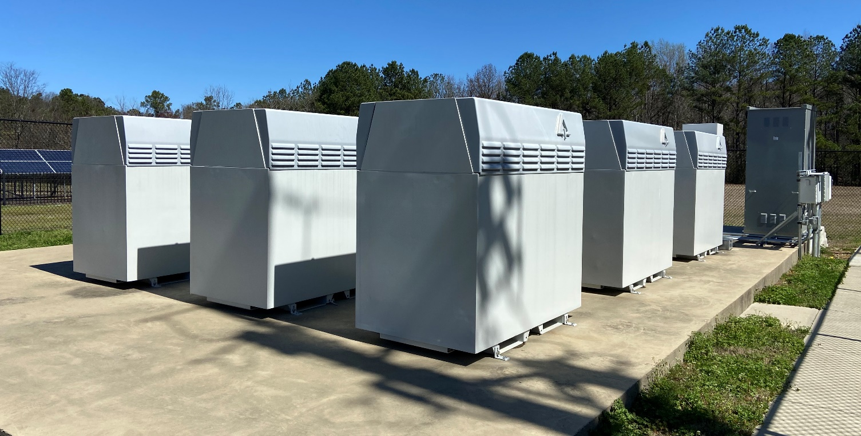
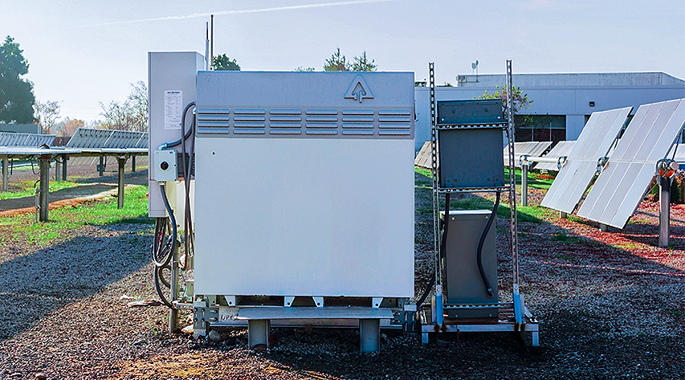
Agenda:
Invinity and our Vanadium Flow Battery
Our view on “Long Duration”
Long duration storage in 2020
Long duration storage in 2030
How the future informs what we should do today.

Slide 3
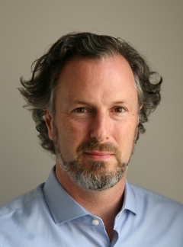
Your Presenter
Matt Harper
Chief Commercial Officer
Avalon Battery founder
Responsible for Invinity’s sales, business development, marketing, and field engagement
Mechanical and systems engineer with 20 years in flow battery & fuel cell industry
Senior positions at VRB Power Systems and Prudent Energy

Slide 4
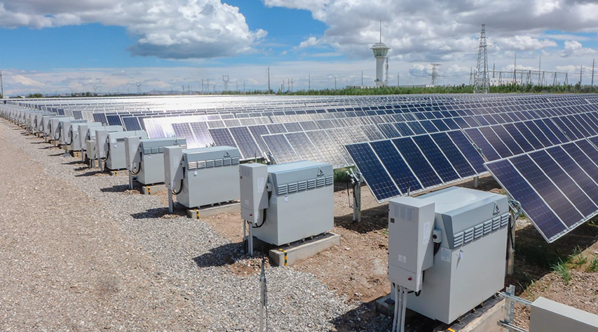
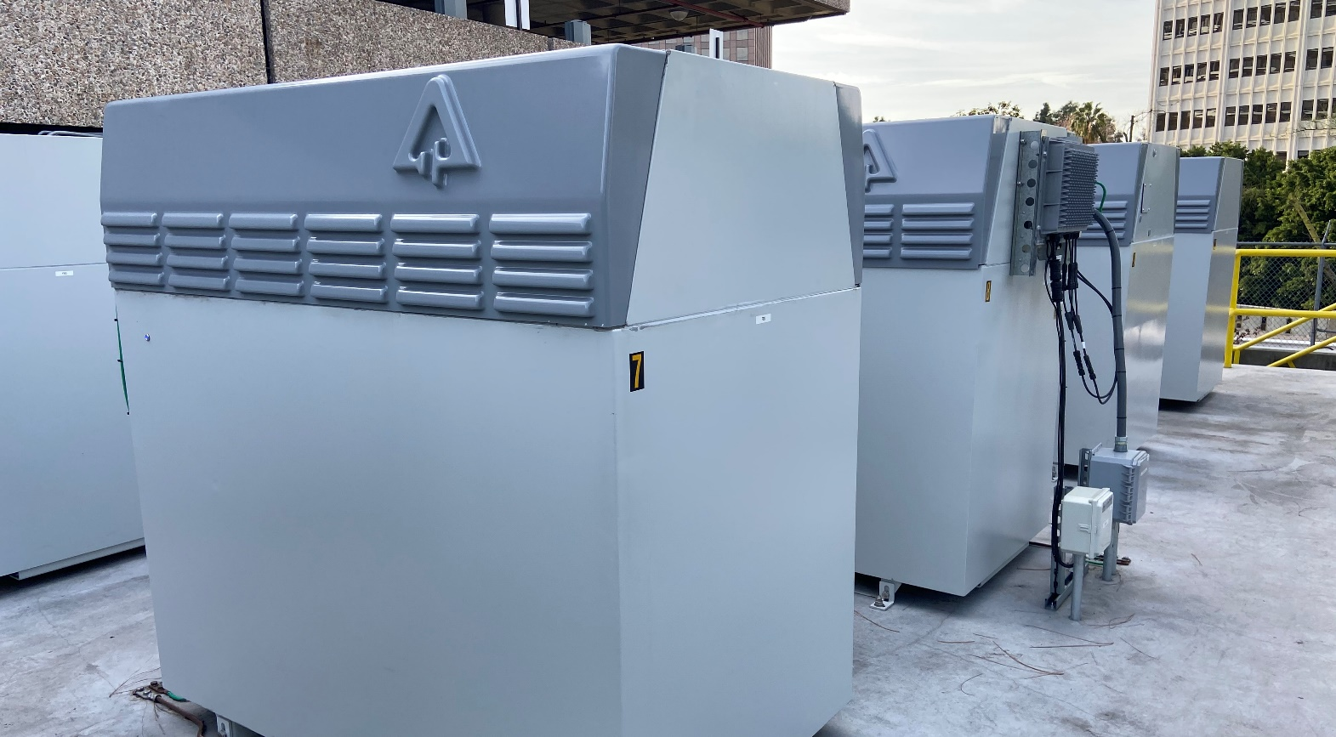
Invinity Energy Systems
Vanadium Flow Batteries (VFB) for businesses, industry, utilities and electricity networks.
Invinity’s VFB:
Commercially proven
Cost competitive
Safe & non-flammable
Fully recyclable
Extremely durable
Our VFBs make renewable energy reliable, delivering low-cost, low-carbon power on demand.
>10MWh installed worldwide
Europe, Asia, North America, Australia and Africa
Publicly traded, London Stock Exchange listed (AIM:IES)

Slide 5
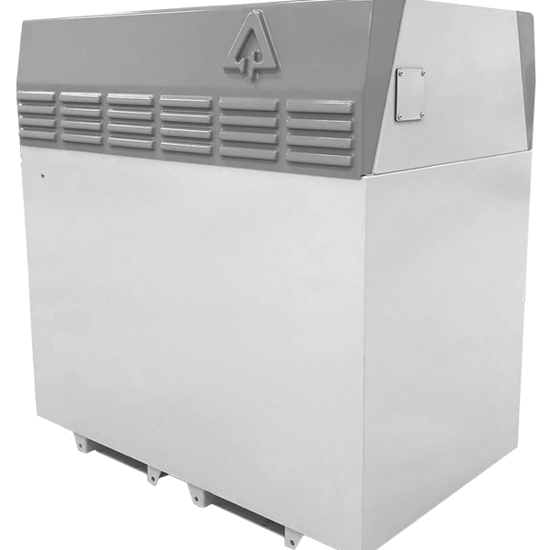
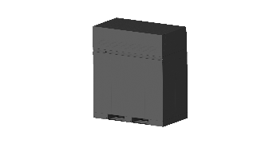
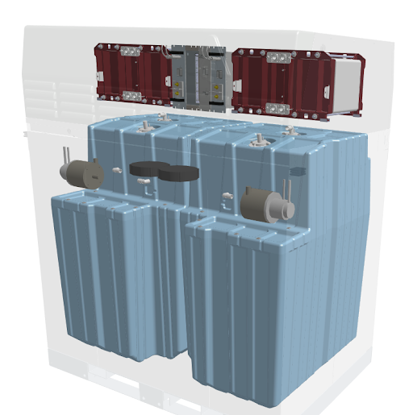
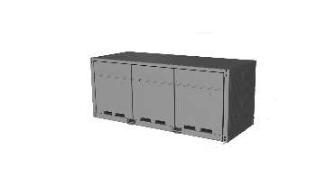
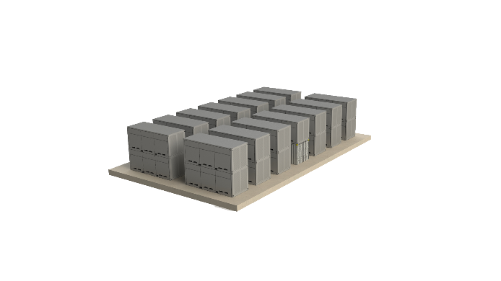
Invinity’s Foundation: Proven Battery Module
VS3 Internals
Scalable Architecture
Invinity VS3
Stacks (Power)
Power Electronics
Battery Module
40 kWh, 10 kW module
Includes BMS, cooling, enclosure.
Building block for projects from 250 kWh to 12 MWh
Electrolyte Pumps
Battery Pack
3rd generation, self-contained vanadium flow battery
Shipped fully functional from factory
One of the largest fleets of identical flow batteries – over 160 operating in the field
Standardized “building block” for all future projects.
Tank Set (Energy)
Battery
Cluster

Slide 6
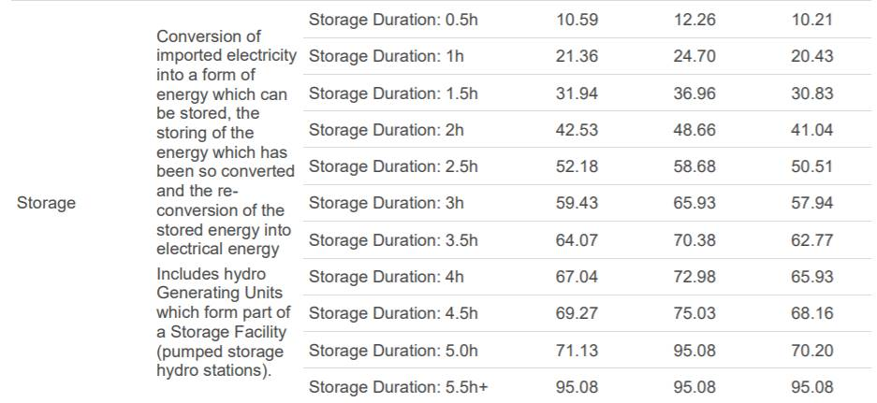
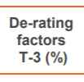
Defining ‘Long Duration’
Common definition?
Duration, product or application?
Our view: ‘Long Duration Storage’ is:
A market-driven application, where
Hours of discharge force a divergence away from conventional project economics
What factors define these boundaries?
On markets: regulation
On economics: The effective cost of useful energy
What long duration opportunities currently exist?
Capacity market derating factors, February 2020

Slide 7
Long Duration 2020
Transition to a renewable, distributed energy system creating opportunities
Key Applications in 2020
Flow Batteries
Application | Duration | Cycle Count | Driving Opportunity
C&I solar + storage | 4 – 6 hours | High (daily+) | Low-cost dispatchable solar
Grid Services Providers (“GSP”) | 2.5 – 5 hours | High (daily+) | Ancillary services & Wholesale trading
Electric car charging + PV | 2.5 – 5 hours | High (daily+) | Grid upgrades & Low carbon charging
Communications infrastructure | 4 – 10 hours | High (daily) | Resilience & diesel displacement
Microgrid | 4 – 10 hours | High (daily) | Low-cost dispatchable solar & diesel displacement
Long
Duration
Lithium
Short
< 1.5/day
> 1.5/day
Cycles
What will long duration look like in tomorrow’s market?

Slide 8
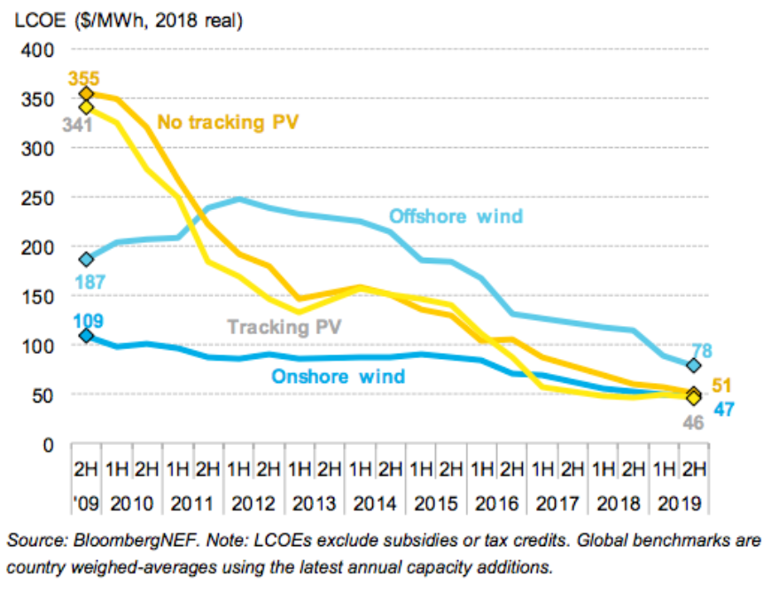
Long Duration 2030: Dispatchable Solar
As in 2020 many opportunities will exist; dispatching solar 24/7 will be one of them
Solar and Wind: cheapest electricity generation across more than two-thirds of the world.
By 2030, solar energy will be cheaper than the marginal cost of operating conventional generation without subsidies or incentives.
Our 2030 grid system will need to:
Meet baseload demand with dispatchable renewables (solar and wind)
Meet stability requirements with low carbon energy
How can we design storage today for this future case?

Slide 9
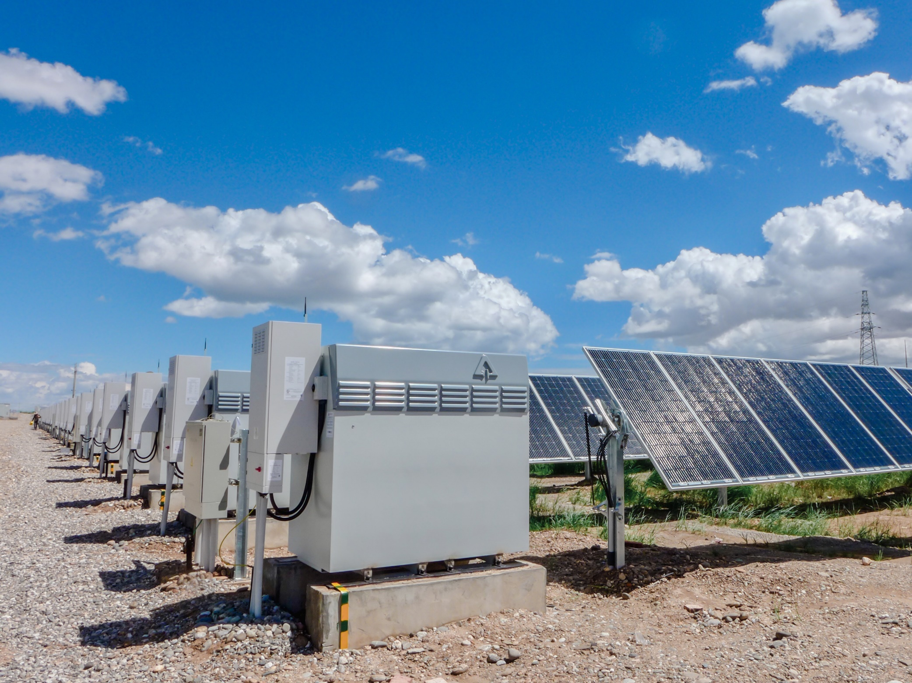
Hints at the Future: Dispatchable PV today
Remote PV microgrids provide guidance on designing storage for a long-duration, high-renewables future.
Important drivers in our modelling:
Duration: Charge < discharge
Storage energy ~3x PV power
Optimization for battery throughput
Low environmental impact of incremental storage duration
PV life = Battery life (25+ years)
100% Dispatchable PV @ $0.13/kWh (LCOE)

Slide 10
Summary & Key Takeaways
Long duration is an application, not a technology
Will be defined by markets and economics
Great businesses exist in long duration storage today
Invinity’s focus: C&I self-generation, grid services, EV charging, microgrids
Long duration will accelerate a high-solar future
Dispatchability and stability must still be maintained; PV will be constrained until solar-generated energy can meet these two criteria
Current high-PV use cases can guide our work
Focus on battery throughput, useful life and environmental impact

