Slide 1
NANOCOMPOSITES: ACCELERATING INNOVATION THROUGH COOPERATION AND CONSENSUS IN STANDARDS May 2015 BSI Standards 020 8996 7261 Alex.Price@BSIgroup.com

Slide 2
Nanotechnology in standards.
Technology | Use Application | Known Manufactured Nanomaterials
Additives within diesel fuel for HGVs | Trucks and buses | Cerium oxide
Biocides | Nanosilver (and, to a leser extent, other nanomaterials) used in a wide array of applications, including medical instruments, pharmaceuticals, textiles, domestic appliances, antimicrobial agents/coatings, biocidal cleaning products (silver nanoparticles) | Nanosilver, various metal oxides, nanostructured biopolymers
Flame retardants | More cost-effective flame retardant for various materials. For instance, nanoclays (sometimes with CNTs) are best used with ABS plastic. Magnesium hydroxide specified in reference #7 is best used with paraffins. | Nanoclays, CNTs, aluminum-hydroxide, magnesium hydroxide, triphenyl phosphate
Batteries | Automobiles and portable electronics | Nano-structured Lithium; Carbon nanotubes; graphene
Additives in Tyres | Automobiles and trucks | silicon dioxide; multi-walled carbon nanotubes; carbon black
Insulation | A variety of current nanotechnology approaches include aerogels and thin film coatings, designed to reduce heat ransfer. Enhanced foams with improved insulation properties and aerogel replcements for windows are being researched | Aerogels (carbon black and silica-based); quantum dots (Cadmium selenide); aluminium oxide
Photovoltaics | anti-reflective and/or self-cleaning capacity coatings for traditional solar cells (titanium dioxide, silicon dioxide), quantum dots in nanocrystal solar cells (lead selenide or cadmium telluride), building integrated photovoltaics (glass application of cadmium selenide, zinc oxide) | Photovoltaics
Lighting | Depending upon the desired color and heat of light, varying sizes and nanostructured semiconductors are used. | cadmium selenide, cadmium sulfide, inidum arsenide, indium phosphide, cadmium selenide sulfide
Water treatment and purification | anitmicrobial treatment to wastewater (metal oxides), water purification (nano-polymers), catalysis of pollutant breakdown (metal oxides) | Water treatment and purification
Nano-zero-valent iron for environmental remediation | Iron corrosion chemistry has been put into productive use in the dechlorination of prganic solvents, detoxification of pesticides, imobilization of metals and transformation of fertilisers | Zero valent Iron nps
Lightweighting | Nanocomposites are valued in automotive applications for their improved physical properties and their ability to produce parts with reduced weight | CNTs, aerogels, graphene

Slide 3
Nanomaterials and composites.
Dynamic light scattering (DLS); Differential
centrifugal sedimentation (DCS) / Centrifugal
liquid sedimentation (CLS); Nanoparticle tracking
analysis (NTA); Tuneable resistive pulse sensing
(TRPS); Surface area; X-ray photoelectron
spectroscopy (XPS); Atomic force microscopy
(AFM); Electron microscopy
Mechanical properties, such as strength, impact, toughness.
Barrier properties, such as chemical and gas resistance.
Polymer matrix nanocomposites
Nano material the building blocks, for better Polymer matrix nanocomposites.
Fire properties such as resistance and reaction.
Electrical properties such as resistance and conductivity.
Notes:
ISO/TR 12885:2008 Nanotechnologies -- Health and safety practices in occupational settings relevant to nanotechnologies
ISO/TS 12901-1:2012 Nanotechnologies -- Occupational risk management applied to engineered nanomaterials -- Part 1: Principles and approaches
ISO/TR 13121:2011 Nanotechnologies -- Nanomaterial risk evaluation
ISO/TR 13329:2012 Nanomaterials -- Preparation of material safety data sheet (MSDS)
ISO/TS 13830:2013 Nanotechnologies -- Guidance on voluntary labelling for consumer products containing manufactured nano-objects
ISO/TS 12901-2:2014 Nanotechnologies -- Occupational risk management applied to engineered nanomaterials -- Part 2: Use of the control banding approach

Slide 4
Nano composite Standards highlights
Cellulose nanomaterials:
Back in 2014 there was a number of events identifying⁽¹⁾ the technical barriers in the commercialization of cellulose nanomaterials with expert input from user communities.
Typical lateral dimensions are 5–20 μm.
ISO/DTR 19716 Nanotechnologies — Characterization of cellulose nanocrystals
Cellulose nanomaterials are materials in the nanoscale that are either manufactured by breaking down feedstocks such as plants, other cellulose materials, or produced directly by living organisms.
A few companies already produce Cellulose nanomaterials containing products.
Rather than delaying standards development until knowledge accumulated with market maturity is available the draft technical report is aiding the market.
(1) http://www.tappinano.org/media/1073/2014-usfs-nih-cellulose_nano_workshop_report.pdf

Slide 5
Nano composite Standards highlights
Antibacterial silver nanoparticles (NPS)
NPS is water based solution containing nano-particles of silver.
Antibacterial silver nanoparticles probably one of the most common known and used it has never been standardised until now.
ISO/TC 229 / SC N 1246 Nanotechnologies – Materials specification - Antibacterial silver nanoparticles
Silver nanoparticles are releasing more silver ions when comparing with non-nanoscale silver particles.
There is no appropriate standardization to specify antibacterial properties for silver nanoparticles, thus most manufacturers or business owners of antibacterial silver nanoparticle have been used existing antibacterial test standards to evaluate antibacterial properties.:
BS ISO 22196:2011 Measurement of antibacterial activity on plastics and other non-porous surfaces
BS EN 14349:2004 Chemical disinfectants and antiseptics. Quantitative surface test for the evaluation of bacterial activity of chemical disinfectants and antiseptics used in the veterinary field on non-porous surfaces without mechanical action. Test method and requirements.

Slide 6
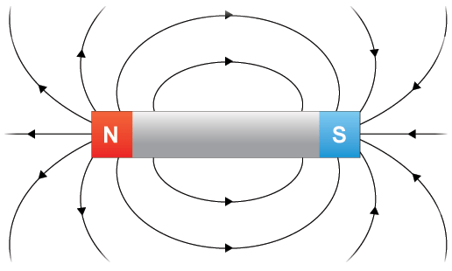
Nano Standards Highlights
Magnetic Nanoparticles
Identifies emerging applications for magnetic nanoparticles (MNPs) in cancer therapy and drug delivery, and the subsequent importance of the standardisation of magnetic nanoparticles.
MNPs are currently being employed in a wide range of biomedical applications including bioassays, cell sorting and purification, medical imaging, drug delivery and hyperthermia therapy.
Existing standards development work in Biotechnology and Health informatics.
Companies are already producing and using magnetic nanoparticles, these are expected to benefit directly from standardization work within this field.
Shock absorbers provide the comfortable ride we experience today in vehicles ranging from sports cars to sport utility vehicles and pickup trucks. Nanotechnology – specifically magnetic nanoparticles – are advancing shock absorber capabilities further than ever before.
Magnetic fluids are comprised of magnetic nanoparticles in a fluid suspension. Depending on the size of the nanoparticles, the magnetic fluid may be able to change its apparent viscosity in proportion to the strength of the magnetic field applied to it.

Slide 7
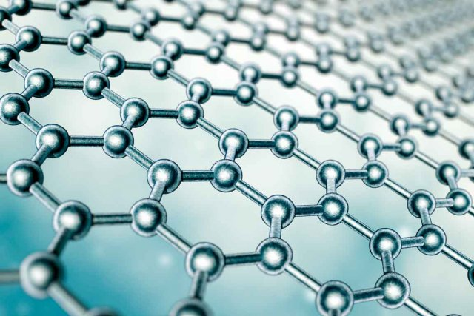
Nano Standards Highlights
Graphene
The new wonder 2D material discovered at University of Manchester.
Not exempt from Standards developments in ISO and IEC:
Terminology:
NP - NEW WORK ITEM PROPOSAL ISO/IEC TS 80004-13 Nanotechnologies – Vocabulary – Part 13 Graphene and other two dimensional materials
Domains and defects:
NWIP Nanomanufacturing – Key control characteristics – Graphene – Characterization of graaphene domains and defects
Properties:
PWI 'Nanotechnologies - Structural characterization of graphene'
Blank details:
N 1267 - NWIP 'Nanomanufacturing -- Key control characteristics -- Graphene - Characterization of graphene domains and defects'
Characterisation and measurement:
ISO/NP TR 19733 ‘Matrix of characterization and measurement methods for Graphene
Notes:
IEC/TS 62607-6-2: Nanomanufacturing - Key control characteristics - Part 6-2: Graphene - Evaluation of the number of layers of graphene
IEC/TS 62607-6-3: Nanomanufacturing - Key control characteristics - Part 6-3: Graphene - Evaluation of the defect level in the graphene layer

Slide 8
Nano Standards Highlights
Paints
One of the first commercial applications for nano was the use of carbon nanotubes in paints.
To reduce the build up algae and barnacles which could not adhere to hulls on ships.
BS EN 15458:2014 Paints and varnishes. Laboratory method for testing the efficacy of film preservatives in a coating against algae
Saving money on cleaning, huge fuel savings and replacing previous coatings which were dangerous to marine life.
The paint used on the Forth Bridge is said to include nano components - but now, instead of needing to start painting the bridge again when they have just finished it, as the saying goes - the bridge won't need painting for 25 years!

Slide 9
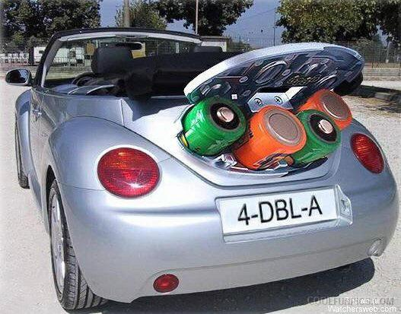
Nano composite Standards highlights
Batteries for road vehicle use.
Is lithium ion last generation?
lithium-oxygen demonstrator cell with a higher energy capacity, increased efficiency and improved material stability over that of previous attempts, with a graphene electrode.
Battery Dimensions and shape
PD ISO/IEC PAS 16898:2012 Electrically propelled road vehicles. Dimensions and designation of secondary lithium-ion cells, which details the 3 main shapes for use within road vehicle:
Performance Testing.
The main standards revolve around BS EN ISO 12405 which was developed by ISO/TC 22, Road vehicles, Subcommittee SC 21, Electrically propelled road vehicles. The standard specifies test procedures for lithium-ion battery packs and systems for use in electrically propelled road vehicles.
Notes:
Performance test: Thermal equilibration, Standard charge (SCH), Standard cycle (SC) Discharge at 1 C Standard charge (SCH), Discharge at 1 C, Standard charge (SCH), Discharge at 10 C, Standard charge (SCH), Standard cycle (SC)
The testing within the standard I think is very much geared to complete battery systems within the ELV. However they can be appropriately extrapolated to the testing of individual cells. Testing on cell level is specified in IEC 62660-1 and IEC 62660-2. For specifications for battery cells:
BS EN 62660-1:2011 Secondary lithium-ion cells for the propulsion of electric road vehicles — Part 1: Performance testing
BS EN 62660-2:2011 Secondary lithium-ion cells for the propulsion of electric road vehicles. Reliability and abuse testing
Based on tests, the purpose of the standard is to provide a basic test methodology with general
versatility, which serves a function in common primary testing of lithium ion cells to be used in
a variety of battery systems.
Other standards of note which are called up in Battery testing procedures but these are more around environmental conditions during testing:
BS ISO 6469-1, Electrically propelled road vehicles — Safety specifications — Part 1: On-board rechargeable energy storage system (RESS)
BS ISO 6469-3, Electrically propelled road vehicles — Safety specifications — Part 3: Protection of persons against electric shock
BS ISO 16750-1, Road vehicles — Environmental conditions and testing for electrical and electronic equipment — Part 1: General
BS ISO 16750-3, Road vehicles — Environmental conditions and testing for electrical and electronic equipment — Part 3: Mechanical loads
BS EN 62133:2013 Secondary cells and batteries containing alkaline or other non-acid electrolytes. Safety requirements for portable sealed secondary cells, and for batteries made from them, for use in portable applications
BS ISO 16750-4: Road vehicles — Environmental conditions and testing for electrical and electronic equipment — Part 4: Climatic loads
BS IEC 60068-2-30, Environmental testing — Part 2-30: Tests — Test Db: Damp heat, cyclic (12 h + 12 h cycle)
BS IEC 60068-2-47 Environmental testing — Part 2-47: Test — Mounting of specimens for vibration, impact and similar dynamic tests
BS IEC 60068-2-64:2008, Environmental testing — Part 2-64: Tests — Test Fh: Vibration, broadband random and guidance

Slide 10
Nano standards highlights
Tyres, and nano-clays being used.
Reference: OECD releases ⁽¹⁾ Report looking to advance Policy Debate on Nano through Case-Study on its Application to Tyre Industry
Qualifying the improvement in the testing around rolling road resistance and fuel-economy did demonstrate and improvement in the performance against traditionally formulated tyres.
BS ISO 18164:2005 Passenger car, truck, bus and motorcycle tyres. Methods of measuring rolling resistance
ASTM F2803 - 09(2015) Standard Test Method for Evaluating Rim Slip Performance of Tires and Wheels
⁽¹⁾ http://www.nanotechia.org/news/news-articles/oecd-releases-report-looking-advance-policy-debate-nano-through-case-study-its

